Slide 1
Package Principles
Principles of Object Oriented Design

Slide 2
What is package principles?
Package principles are a way of organizing classes in larger systems to make them more organized and manageable. They help to understand, which classes should go into which packages – (package cohesion – ) and how these packages should relate with one another – (package coupling).
In this context a package is a binary deliverable like a .jar file, or a dll as opposed to a namespace like a java package or a C++ namespace.

Slide 3
Cohesion package principles
What to put inside package?
The Release Reuse Equivalency Principle (REP)
The granule of reuse is the granule of release.
The Common Closure Principle (CCP)
Classes that changes together are packaged together.
The Common Reuse Principle (CRP)
Classes that are used together are packaged together.

Slide 4
Reuse-release equivalence principle (REP)
The granule of reuse is the granule of release. Only components that are released through a tracking system can effectively be reused. This granule is the package.
This means that in order to effectively reuse code it must arrive in a complete, black-box, package that is to be used but not changed. Users of the code are shielded from changes to it because they can choose when to integrate changes from the package into their own code. While this supports code ownership, and even promotes it, it does not enforce it.

Slide 5
Common Closure Principle (CCP)
Classes within a released component should share common closure. That is, if one needs to be changed, they all are likely to need to be changed. What affects one, affects all.
More important than reusability, is maintainability.
The CCP is an attempt to gather together in one place all the classes that are likely to change for the same reasons. If two classes are so tightly bound, either physically or conceptually, such that they almost always change together; then they belong in the same package.

Slide 6
The common reuse principle (CRP)
The classes in a package are reused together. If you reuse one of the classes in a package, you reuse them all.
Сlients of a class will have compile, link, and/or testing dependencies on an entire package instead of just the classes it directly uses. What it means is that if a client relies on one class in a package then it should rely on all of them. It tries to push classes that aren't reused together into separate packages.

Slide 7
Principles of coupling between packages.
Metrics that evaluate the package structure of a system.
The Acyclic Dependency Principle (ADP)
The dependency graph of packages must have no cycles.
The Stable Dependency Principle (SDP)
Depend in the direction of stability.
The Stable abstractions Principle (SAP)
Abstractness increases with stability.

Slide 8
The Acyclic Dependency Principle (ADP)
The dependency structure between packages must not contain cyclic dependencies.

Slide 9
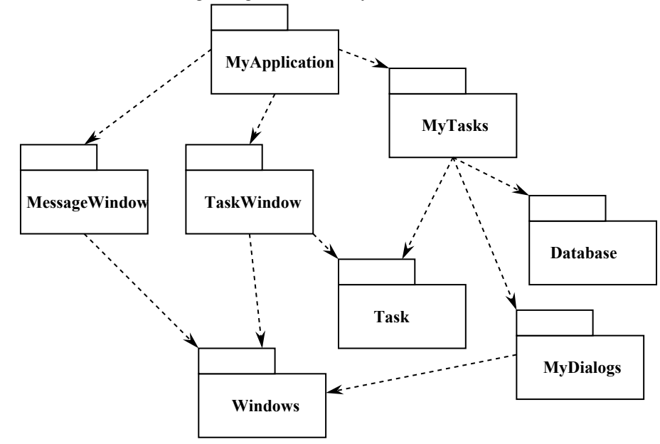

Slide 10
The Stable Dependency Principle (SDP)
The dependencies between packages should be in the direction of the stability of the packages. A package should only depend upon packages that are more stable than it is.
"Stable" roughly means "hard to change", whereas "instable" means "easy to change".
With those definitions, you don't want to maximize stability of all packages. You need instable packages, or your software cannot change easily. If you're doing your job well, the hard-to-change packages will be the ones you never need to change, and the easy-to-change packages will be the ones you have to change frequently. The principle is that no package should be dependent on packages that are more likely to change than it is.

Slide 11
The Stable Abstraction Principle (SAP)
Packages that are maximally stable should be maximally abstract. Unstable packages should be concrete. The abstractness of a package should be in proportion to its stability.
Measuring Abstraction:
The A metric is a measure of the abstractness of a package. Its value is simply the ratio of abstract classes in a package to the total number of classes in the package.
A = abstractClasses / totalClasses

Slide 12
SPASIBO ZA VNIMANIE

